Slide 1
AI VIRTUAL ASSISTANT
Empower Meeting Collaboration
AI VIRTUAL ASSISTANT

Slide 2
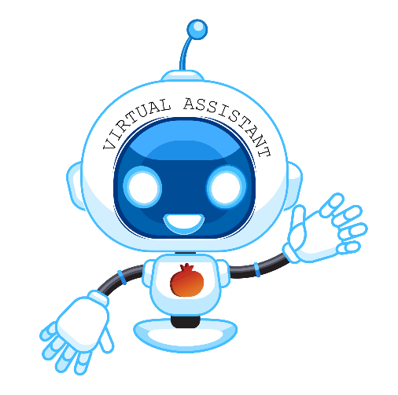
AGENDA
Challenges & Benefits
Targeted Services
Meeting Content
Meeting Highlights
Action Items
Meeting Minutes
Features

Slide 3
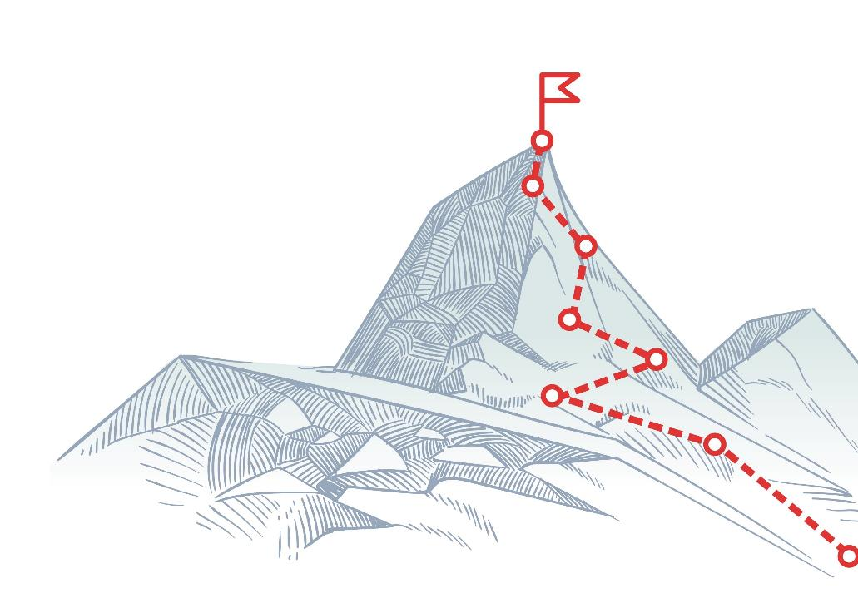
CHALLENGES
Keep up with decisions and action items set
Non-effective meeting discussions done by email
Focus on the conversation taking place
Participating in the call vs taking meeting minutes
Bringing non-participants up to speed
Take advantage of existing sentiment data

Slide 4
BENEFITS
Don’t let any item fall between the cracks
Central Meeting Collaboration Place
Achieve a better continuous collaboration
Stay focused on your meeting
Save time by automating meeting management process
Facilitate the process of bringing people up to speed
Improve communication and identify risks with Meeting Sentiment

Slide 5
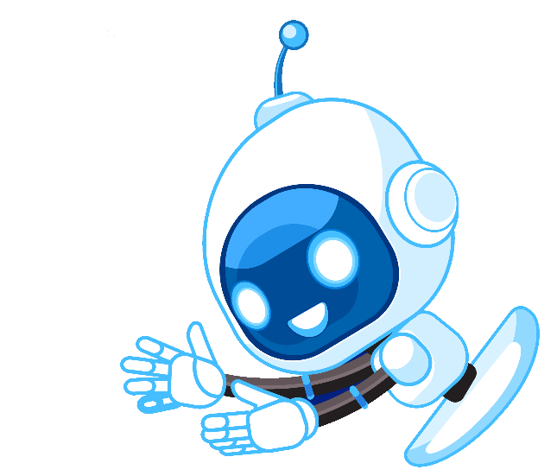
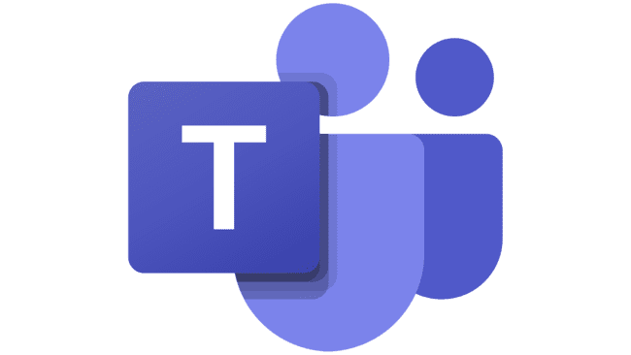
TARGETED SERVICES
Microsoft Teams
Cisco Webex
Zoom
*Coming Soon*

Slide 6
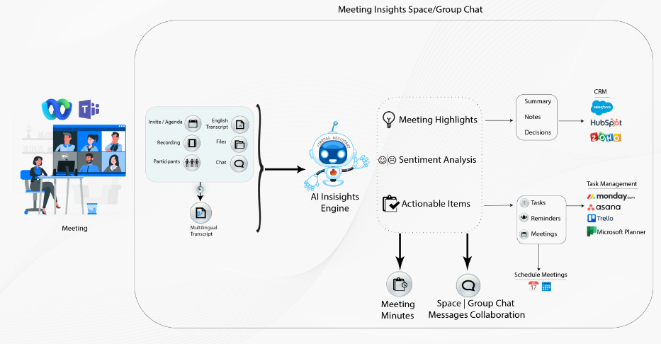
HOW VIRTUAL ASSISTANT WORKS

Slide 7
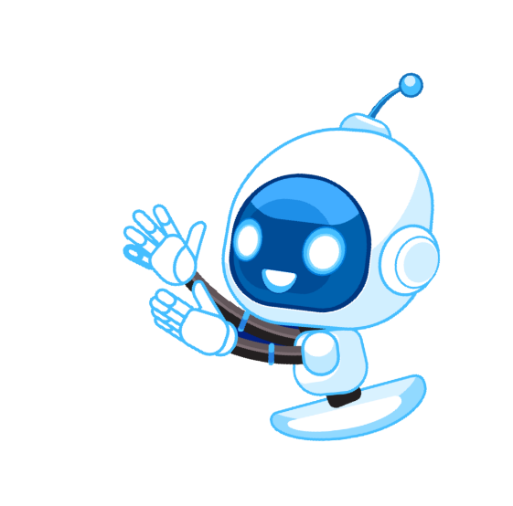
HOW VIRTUAL ASSISTANT WORKS
Assistant core technology is an AI Engine analyzing meeting transcript
Insights are detected by the AI Engine and are managed in space/group chat in conjunction with meeting content
Insights include decisions, summary, tasks, reminders, notes, scheduled follow up meetings & sentiment analysis

Slide 8
FEATURES

Slide 9
CENTRAL MEETING COLLABORATION PLACE
A Webex Space / MS Teams Group Chat is automatically created, and participants are added as members for continuous flow before, during and after the meeting.
THE SPACE / GROUP CHAT INCLUDES TABS FOR:
Meeting Content: Meeting Information (Participants, Time), Recording, Transcript, Chat & Files
Highlights:
Agenda, Decisions, Notes & Summary
Action Items:
Tasks & Reminders
Meeting Minutes

Slide 10
MEETING CONTENT
MEETING TRANSCRIPT:
Meeting transcript from vendor includes who was the speaker and the time of utterance
Transcript translation into dozens of other languages
MEETING INFORMATION:
Including: agenda, time, date & participants
MEETING RECORDING:
Link to the meeting recording
CHAT & FILES:
Meeting chat and files shared

Slide 11
MEETING HIGHLIGHTS
Decisions, Notes & Summary
Automatically extract decisions, notes and a summary from transcript by smart analysis
Agenda
Extract the agenda from the meeting invitation
Allow participants to comment and discuss agenda before the meeting
Summary
Automatically generate a meeting summary based on AI module

Slide 12
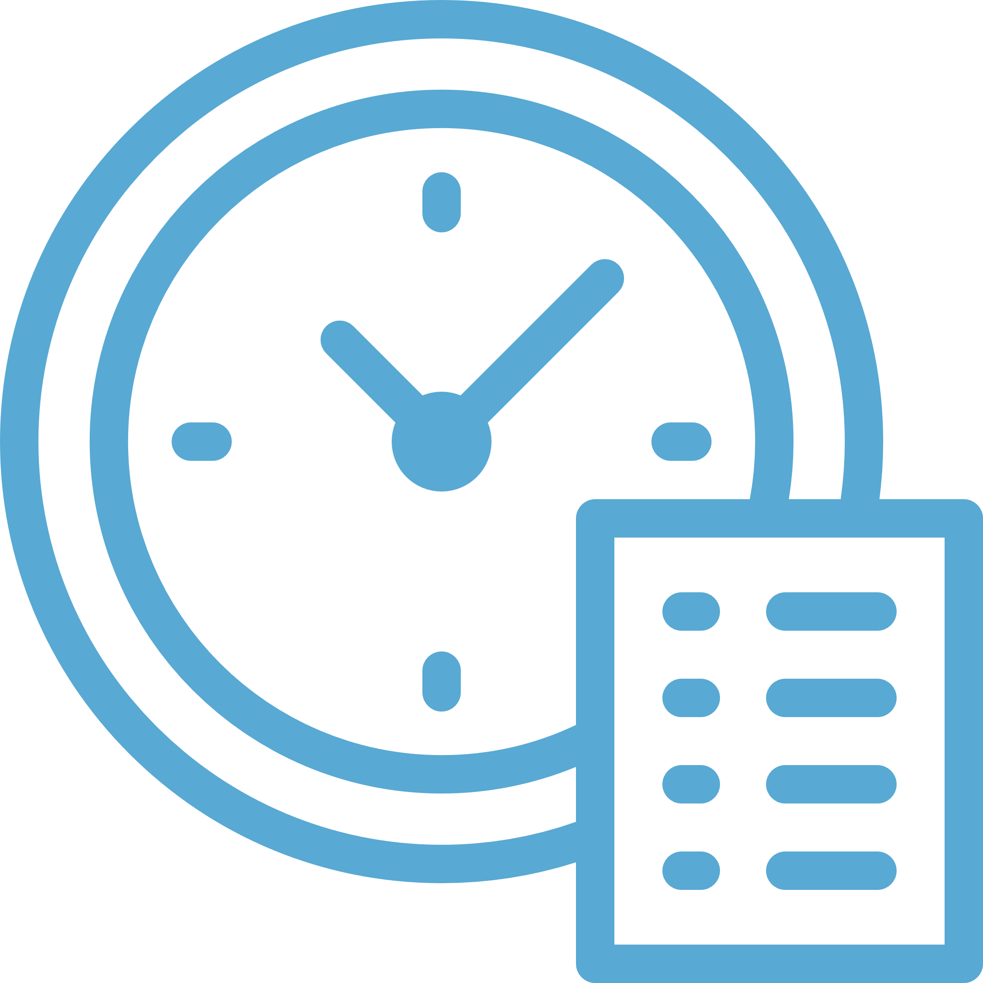
TASKS
Create a list of actionable tasks in your preferred task management system
Asana, Microsoft Planner, Monday, Trillo and more
Detect task title, assignee and due date
ACTION ITEMS
Review and modify tasks to complete info such as description, priority, project
Automatically extract action items by using AI Virtual Assistant and smart analysis - tasks, reminders and follow up meetings
2-way sync to display live task status

Slide 13
ACTION ITEMS
REMINDERS:
Create a list of reminders
Detect title and due date
Manage recommended list of reminders and post notifications automatically in space / group chat when the time is due
Follow up meetings
Automatically schedule follow up meetings

Slide 14
Automatic generation of meeting minutes - an instant written record of a meeting – including:
MEETING MINUTES
Notes
Notes are synced to your customer account data in your preferred CRM system
Meeting information – title, time & participants
Agenda
Summary
Decisions
Action Items – tasks, reminders & scheduling meetings
Transcript
Chat
Files
- Export meeting minutes as PDF

Slide 15
CRM INTEGRATION
Notes
Notes are synced to your customer account data in your preferred CRM system
Tasks
Customer related tasks are synced to your CRM (coming soon)
Notes
Notes are synced to your customer account data in your preferred CRM system
Notes
Notes are synced to your customer account data in your preferred CRM system

Slide 16
CONTINUOUS COLLABORATION WITH SPACE / GROUP CHAT
Notes
Notes are synced to your customer account data in your preferred CRM system
Mark anything from the meeting transcript, highlights or action items and post them into space / group chat for further discussion after the meeting
Notes
Notes are synced to your customer account data in your preferred CRM system
Allow discussion on different topics before, during and after the meeting

Slide 17
IMPROVE COMMUNICATION WITH MEETING SENTIMENTS
Listen back to sections identified as positive or negative
Analyse meeting transcript using AI Engine to detect sentiment behind speech
Identify positive and negative interactions for extra attention or cloning positive behaviour
Display positive, negative and overall score of all meetings

