Slide 1
SPHERESHIELD FOR
MICROSOFT TEAMS O365
(EXCHANGE/ONEDRIVE/SHAREPOINT)
Compliance & Security

Slide 2
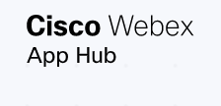
OVERVIEW OF AGAT SOFTWARE
PLATFORMS
Skype
Teams
Webex
Slack
Zoom
RingCentral

Slide 3
SPHERESHIELD MAIN CAPABILITES
INLINE REAL – TIME DLP
ETHICAL WALL
ARCHIVE & EDISCOVERY
Inspect Content passing Through Microsoft Teams in Real Time
Control External and Internal Communications and Permissions
Compliance Archive. Search and Export Information Easily and Fast.
CHANNEL MANAGEMENT
RECORDING AI COMPLIANCE ANALYSIS
RISK ENGINE
Move. Archive and Export Channels in Microsoft Teams
Audio & video analysis for DLP and eDiscovery Needs
Geofencing and User and Entry Behavior Analytics (UEBA)

Slide 4
ETHICAL WALL

Slide 5
Control who can communicate with whom
ETHICAL WALL
Federation with external, users/ Guests
Internal communication between different AD/AAD groups/users/domains/Teams
Control specific collaboration
options
Control communication
types between users
Including:
IM’s,
file-sharing, Audio/Video/Screen-sharing

Slide 6
SAMPLE POLICIES: INTERNAL AND EXTERNAL
MY COMPANY
Federated Company A
MY COMPANY
Federated Company B
Limit Policy
Allow Policy
Limit Policy
Block Policy
IM
IM
IM
IM
Audio/Video
Audio/Video
Audio/Video
Audio/Video
Group A
Files
Files
Files
…..
Files
…..
…..
…..
Group A
Allow Policy
Block Policy
Block Policy
IM
IM
IM
Audio/Video
Audio/Video
Audio/Video
Files
Files
Files
…..
…..
Other Group
…..
Group B
Group C
External Block Using Ethical Wall
Internal Using Ethical Wall

Slide 7
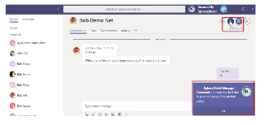
FEATURES
Covers all MS Teams scopes: Chat, Teams & Channels and meetings
Notifications – Popups and In-context
Auditing and reports for training and awareness
Works like a firewall – scans policies from top to bottom
NOTIFICATIONS
In content Message
Action Feedback Popup

Slide 8
 | Microsoft | AGAT
License → | Information Barriers Available only with E3+E5 Compliance | Ethical Wall
Granular control of Internal Communication | ✓ | ✓
Granular control of External Communication | ✗ | ✓
Control Modalities (IM’s/files/audio/video/sharing) | ✗ | ✓
Can be fully controlled by compliance role only | ✗ | ✓
Web User Interface (GUI) – Easy to operate | ✗ | ✓
External system integration/SIEM | ✗ | ✓
Restrict Guests communication only to Team members | ✗ | ✓
Restrict access for guest only to specific channels in a team | ✗ | Soon
Price/User/Month | $10 - $15 | $1.2
ETHICAL WALL – COMPARISON SPHERESHIELD VS MICROSOFT INFORMATION BARRIERS

Slide 9
REAL-TIME DLP INSPECTION

Slide 10
MAIN FEATURES
Inspect messages, Files (Audio, Video inspection with Compliance Recording)
Block, Mask, Notify
Complete Scope – policies apply to Teams/Channels/Chat/Meetings
Create Granular policies based on External Traffic/ Users/Groups/Teams.
Notifications to end-user (in context or pop-up)
Incidents are displayed in SphereShield Admin Portal along with content and AD users info. As well as links to eDiscovery
General DLP Demonstration

Slide 11
DLP INTEGRATION
Sending messages and files to existing DLP vendors or SphereShield DLP engine to meet existing policies. incidents will be displayed at the vendor’s incident manager

Slide 12
Realtime DLP (Active) - Preventing sensitive data being sent to the cloud and reaching destination
Scan all content used in Teams (stored in Exchange, OneDrive, SharePoint)
DLP ADDED ADVANTAGES
Prevent sensitive data from being sent to external users
Scan data shared with external / guest users
Taking advantage of existing DLP infrastructures, experience and policies
Audio & Video Data Loss Prevention (Available with Recording AI Compliance Analysis)
Inspect Files for Custom Rules

Slide 13
DLP – COMPARISON SPHERESHIELD VS MICROSOFT ADD-ON
 | Office 365 (add on) | AGAT
Sensitive data blocked from reaching destination user | ✗ | ✓
Sensitive data blocked from MS Cloud | ✗ | ✓
Real Time Audio inspection | ✗ | ✓
MS Stream recording inspection | ✗ | ✓
Inspect traffic sent to external users | ✗ | ✓
Inspects files for custom rules | ✗ | ✓
Can be controlled by DLP Admin only | ✗ | ✓
Integration with existing Vendors | ✗ | ✓
Price/User/Month | $10-$15 | $1.2

Slide 14
RECORDING AI COMPLIANCE ANALYSIS

Slide 15
RECORDING AND ANALYSIS
Archiving
Audio
Video
eDiscovery Search
Meeting Recording
MS Team
DLP Ethical Wall
Files
Messages
Validation

Slide 16
MAIN CAPABILITIES
Enforce Recordings based on flexible policies
Transcript of all users meeting audio
Converts speech to text in 70+ languages with automatic language detection
Speaker enumeration: which speaker spoke which words and when.
Meeting eDiscovery - make meeting searchable by many parameters
Automatically Inspect meeting content by DLP and Ethical Wall policies
Audio DLP via Audio transcript – Realtime!
Video DLP via On screen OCR from video and screen/document sharing
Links to eDiscovery
On prem storage of Audio/Video Recordings
Integrated with Leading DLP Vendors

Slide 17
COMPLIANCE RECORDING
 | 0365 | SphereShield
Video/Audio eDiscovery | ✗ | ✓
Create transcript of meeting Audio 70 languages | ✗ | ✓
AI Linguistic Analysis | ✗ | ✓
DLP analysis of Audio transcript | ✗ | ✓
DLP analysis of Video OCR | ✗ | ✓
User Identity detection | ✗ | Soon
Recording enforcement policy | ✗ | ✓
Share Video Externally | ✗ | ✓

Slide 18
ARCHIVE & eDISCOVERY

Slide 19
eDISCOVERY
Advanced search by text, user, dates and more
Archive data on cloud or on site
Integrate with existing eDiscovery systems
Search for personal information and export user data
See message context in incidents
Support files and Messages (Audio&Video Available with Recording AI Compliance Analysis)
Meet GDPR and compliance requirements
Full data dashboard independent of O365

Slide 20
ARCHIVE & eDISCOVERY
 | MS Advanced eDiscovery (Add on) | AGAT
User Friendly | ✗ | ✓
Operated even by non O365 Admin (HR/Compliance) | ✗ | ✓
Audio transcript search | ✗ | ✓
Integrated with existing archiving/database systems | ✗ | ✓
Integrated with DLP (to show context of incident) | ✗ | ✓
Search meeting audio and video | ✗ | ✓
On-prem archive of all data (messages/ files/ recordings) | ✗ | ✓

Slide 21
CHANNEL MANAGEMENT

Slide 22
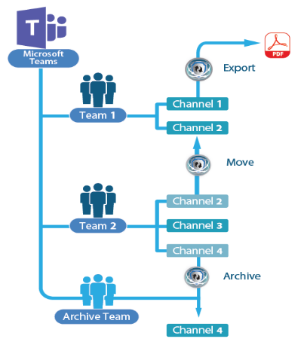
CHANNEL MANAGEMENT
One of the top requested feature in MS Teams user voice
Archive and restore a channel
Move/Copy/Merge channel from one team to another
Moves IM’s, Files, Tabs, Images
Export channel into PDF
Activity auditing
Watch it in Action: https://www.youtube.com/watch?v=E2RLEjzW3Nc

Slide 23
RISK ENGINE
Meet security requirements

Slide 24
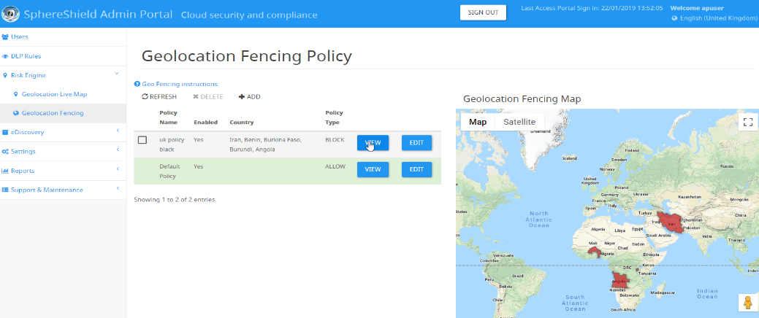
Set Geo Fencing rules based on groups, domains or users.
Allow, block or monitor access from specific countries.
GEO FENCING

Slide 25
USER ENTITY BEHAVIOR ANALYTICS- UEBA
Profile Teams usage (messages, files, hours, devices, IP etc)
Detect anomaly
Create and handle security events
Examples:
Location change / Impossible traveler
Large data consumptions

Slide 26
ADDITIONAL SECURITY SOLUTIONS
Threat protection – Anti Virus/Malware/Phishing
Conditional Access – ensure that users can only log on from a managed device – e.g Blackberry, MaaS 360, Airwatch, Citrix

Slide 27
OPERATION MODES & TOPOLOGY

Slide 28
DLP AND ETHICAL WALL MODES
NEAR REAL-TIME INSPECTION
DETECTION AND AWARENESS
REAL-TIME INSPECTION
Scan data in motion
Content will not reach destination
Communication will be allowed. Incident handling and notification sent shortly after -within seconds (utilizes Webhooks , requires E5 compliance)
Sends notifications after the fact

Slide 29
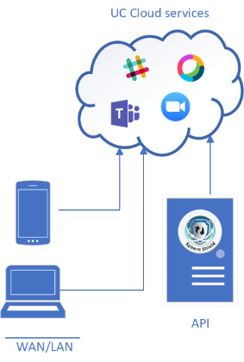
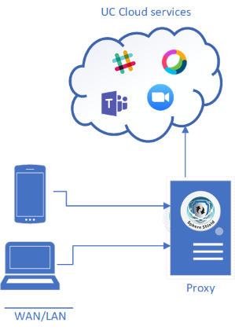
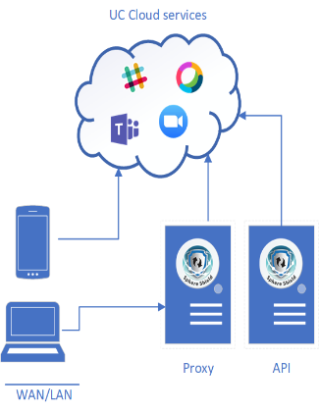
CLOUD TOPOLOGY
API – Near real-time
Proxy – Real-time
Hybrid- Proxy & API

Slide 30
DEPLOYMENT MODES COMPARISON
 |  | Real time using Proxy |  | Near Real time using Adaptor
Policy type |  | Prevent |  | Pro active
 |  | Client configuration | Requirements | Client configuration | Requirements
Mobile |  |  | Agent Certificate
PC | with ADFS |  | Publish ADFS by Bastion
 | without ADFS |  | PAC Certificate
Yes
No
No
Yes

Slide 31
SERVICE OFFERING
SaaS - online service
Customers don’t need to install anything.
Each customer will have dedicated servers
A customer installation solution
Customers install SphereShield in their DMZ or Cloud (e.g. Azure, AWS)
A Free Trial is available

Slide 32
MORE INFO
Visit our website
https://AGATSoftware.com
Contact us
sales@agatsoftware.com
+972-525209860

