Slide 1
SphereShield for ADFS
Enhanced ADFS Protection for Securing Cloud Services
Solution Overview
http://AGATSoftware.com
V1.1

Slide 2
Background
Denial of Service attacks can be performed with an easy effort by sending failed login attempts while only knowing the user name
Microsoft ADFS Extranet Lockout will block the valid user from continuing using cloud services that require ADFS

Slide 3
Solution
SphereShield for ADFS proprietary approach allows to continue using ADFS even while under an attack
Prevents automated attacks/bots and human based attacks
Adaptive authentication options based on real time risk assessment

Slide 4
Features & Benefits
Ability for authorized users to continue using ADFS even while under an attack
Complete account lockout (DDoS) protection
Security auditing logs and reports
Mitigation of ADFS Extranet Lockout Protection’s vulnerability

Slide 5
Features & Benefits
Geo fencing rules & live location map
IP based restrictions
Authentication risk engine
Simple and transparent deployment
No end user training required

Slide 6
Limitations of ADFS Smart Lockout
Smart Lockout relies on leaning known good locations
Allows using ADFS while in attack from known location (IP)
Limitation-
Each change in IP results in location unknown
Attacker can use same IP if IP is static from Network provider
Frequent change in IP while working from mobile
User from mobile will not be able to use ADFS under attack.

Slide 7
SphereShield for ADFS topology

Slide 8
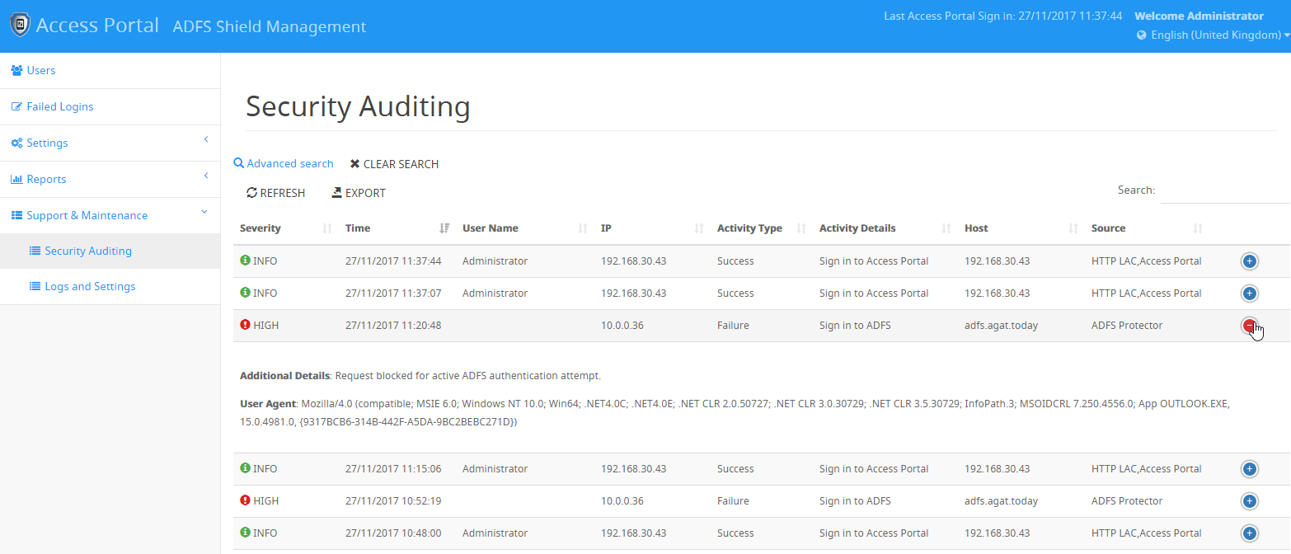
SphereShield security management

Slide 9
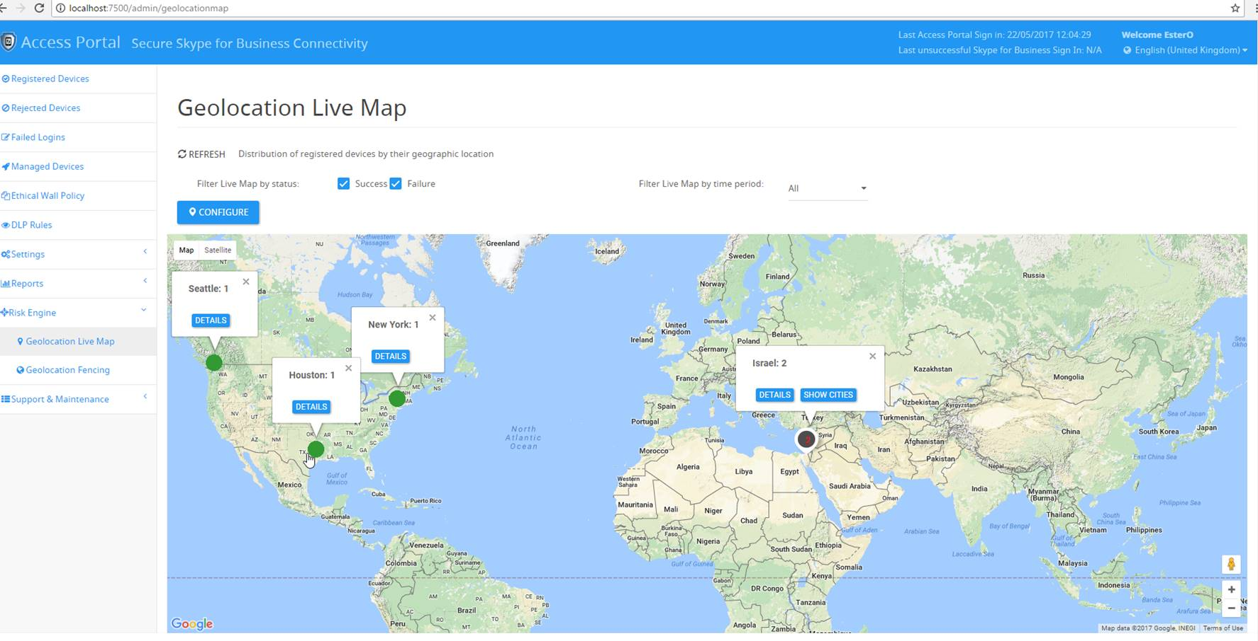
Risk engine – geo location live map

Slide 10
ADFS Protector resources
More information is available here: https://agatsoftware.com/security-solutions/adfs-security
Presentation: https://agatsoftware.com/media/SphereShield-ADFS.pptx
Demo movie: https://www.youtube.com/watch?v=dfVrHjy83Wc&t=1s
Datasheet: http://skypeshield.com/media/SkypeShieldDatasheet.pdf
System Requirements: https://agatsoftware.com/downloads/docs/D6441-ADFSShieldSystemRequirements.pdf?nocache=1
Admin Guide: https://agatsoftware.com/downloads/docs/D6442-AdfsProtectorAdminGuide.pdf?nocache=1

Slide 11
SphereShield platform overview

Slide 12
SphereShield Solution Components
Multi factor authentication
Kerberos
ADFS protection
Cloud ready
In house engine
External vendor integration
Data in motion
Policy engine
Multi parameters condition
Identity and authentication
DLP
Policy control
Adoptive authentication
User profiling
Geo location
Device security level
User Identity
Risk engine
EMM/MDM integration
PKI infrastructure
Digital signature
Integrated engine
External vendor integration
eDiscovery
Disclaimers
Ethicalwall
Encryption
Anti Malware Anti Virus
Compliance & GDPR

Slide 13
Core Technology
Solution is based on AGAT Bastion reverse proxy
Multiple protocol filtering (HTTPS/SIP)
Framework for extending capabilities using pluggable filters for content inspection and access control

Slide 14
SphereShield Partnered Technologies
Infrastructure
EMM/MDM
Data leak Prevention
Microsoft
MobileIron
McAfee
F5 networks
VMWARE AirWatch
ForcePoint
Citrix
IBM MaaS360
Symantec
PKI
BlackBerry
GTB
Faitien
Authentication
Citrix XenMobile
Gemalto
Google authenticator
RSA secureID

Slide 15
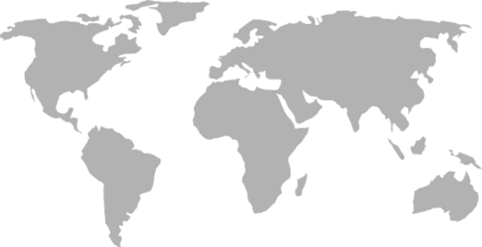
Global presence
Australia
Canada
Denmark
England
France
Germany
Turkey
Netherlands
New Zealand
Norway
Russia
Singapore
Switzerland
Sweden
UK
USA
Wales
Israel
Italy
Luxembourg
Hong Kong
Local partner in most countries

Slide 16
Learn more
Visit our website at
http://SkypeShield.com
http://AGATSoftware.com
Contact us:
info@agatsoftware.com

