Slide 1
SphereShield For Microsoft Teams
O365 (Exchange/OneDrive/SharePoint)
V1.8

Slide 2
Agenda
Solution Overview
Detailed Features & Video demo
Topology
Try it Yourself
Q&A

Slide 3
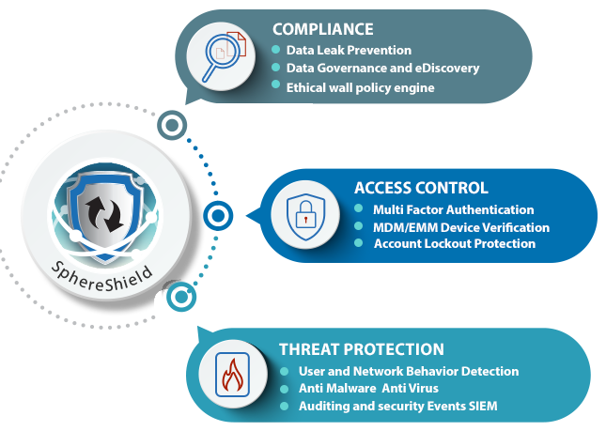
Solution Overview
SphereShield offers advanced compliance and security solutions for Unified Communication services including Microsoft Teams.

Slide 4
Targeted Services
Skype for Business on premises
Skype for Business online (conditional access only)
Microsoft Teams
Office 365 -Exchange, OneDrive, SharePoint
Cisco Webex Teams (Spark)
Slack
Zoom
Microsoft Stream
Ring Central
= Released
=Released Q3,2020

Slide 5
SphereShield for MS Teams features
Ethical wall
Controlling communication participants and controlling capabilities
DLP
Real-time (Active) inspection using internal DLP or leading vendors
eDiscovery
On site archive and search of all communication

Slide 6
SphereShield for MS Teams features (cont)
Compliance recording
Generate searchable voice transcript and on screen (video) OCR, generate recording insights.
Share recording externally. Recording enforcement policy.
Channel management
Archive, export, merge and move channels

Slide 7
SphereShield for MS Teams features (cont)
Conditional Access
Restrict access only to managed devices . Support MobileIron, AirWatch, XenMobile, Blackberry, MaaS360
Risk Engine
Heuristic and AI User & Entity Behavior Analytics (UEBA)
Threat Prevention
Anti Phishing and Anti Malware scanning of messages and files

Slide 8
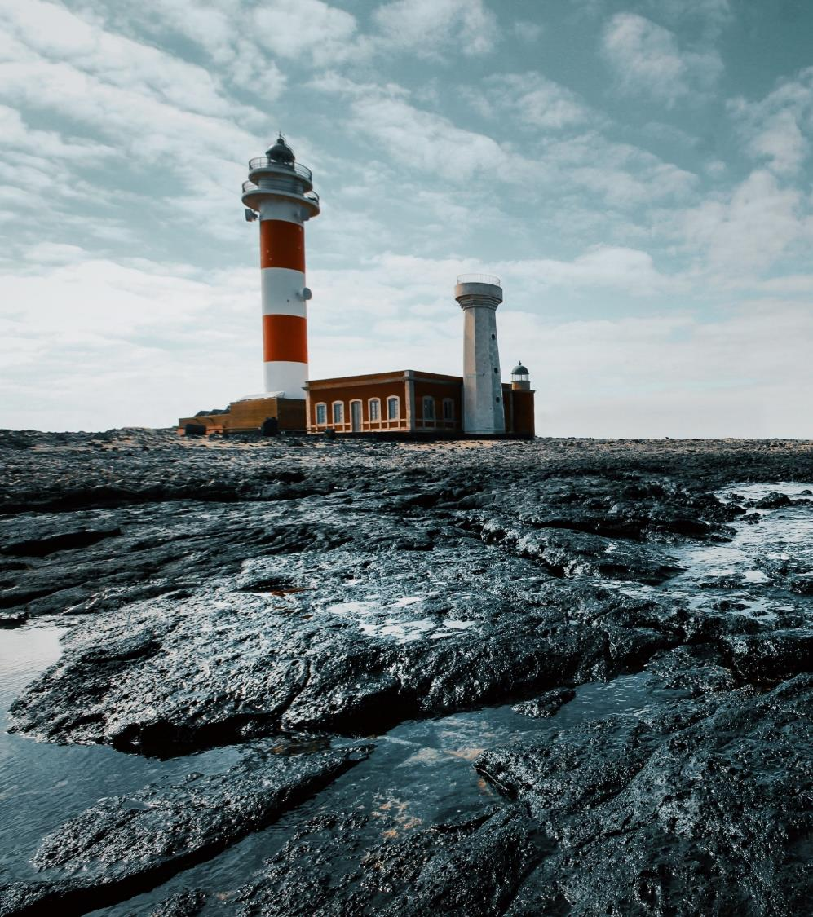
Ethical Wall
Facing compliance, security and privacy requirements.

Slide 9
Ethical Wall
Control who can communicate with whom
Control specific collaboration
options
Federation with external users/ Guests
Control communication
types between users
Internal communication between different groups

Slide 10
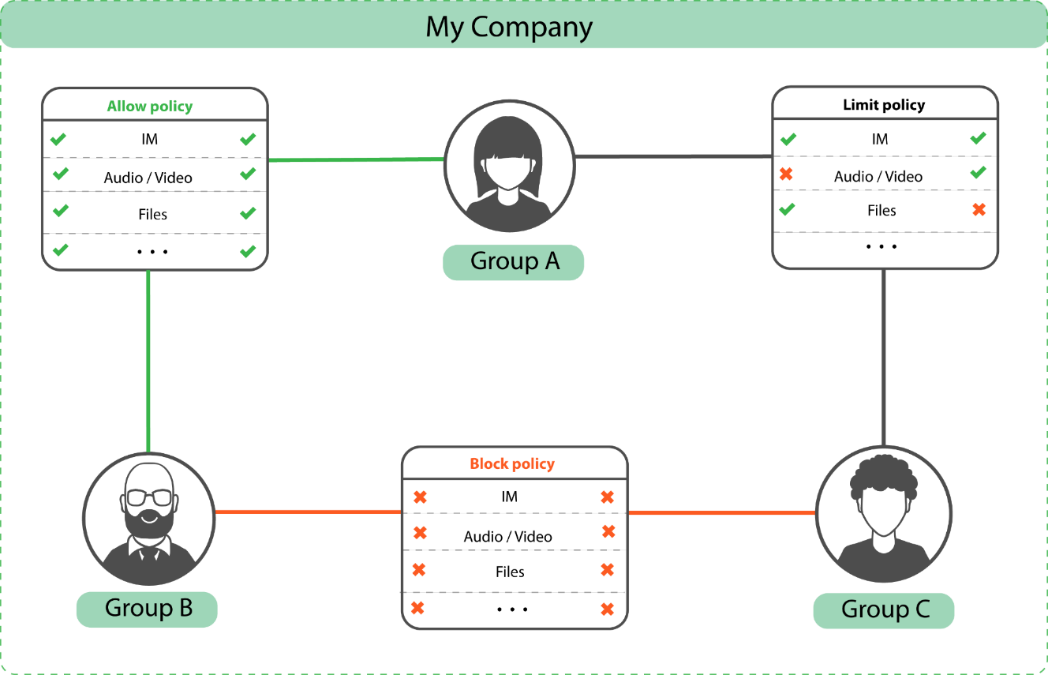
Sample Policy - Internal

Slide 11
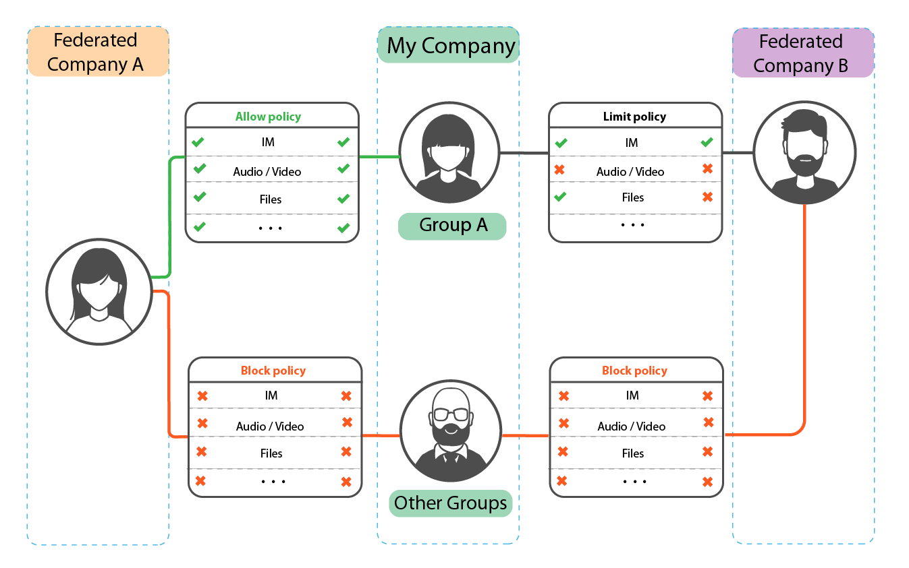
Sample Policy - External

Slide 12
Ethical Wall Video Demonstrations
Internal Block Using Ethical Wall
External Block Using Ethical Wall

Slide 13
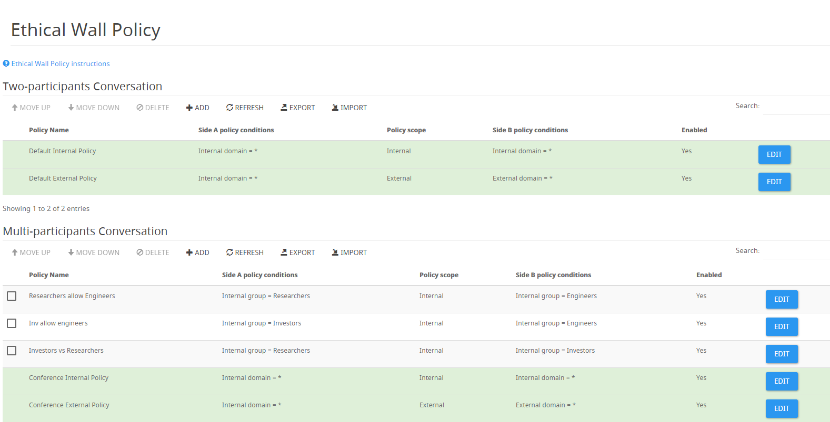
Ethical Wall Policies

Slide 14
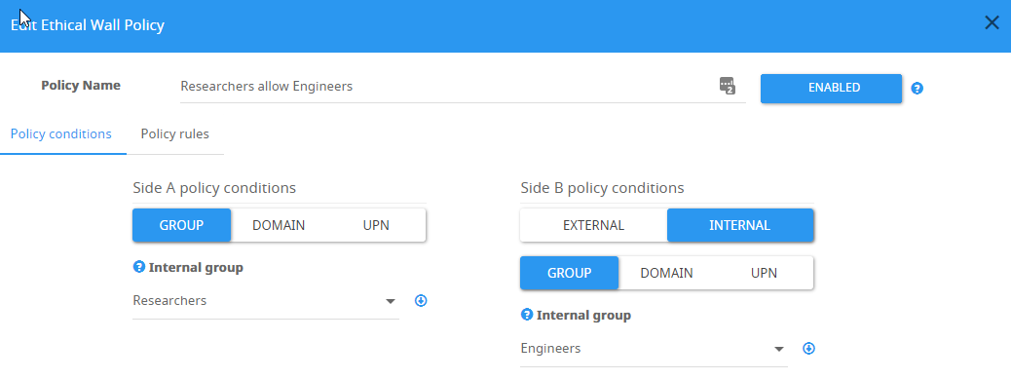
Ethical Wall Policy Condition
Build rule based on
Active directory groups or AAD groups (Azure)
External/Internal domain
External/Internal users
Teams scope

Slide 15
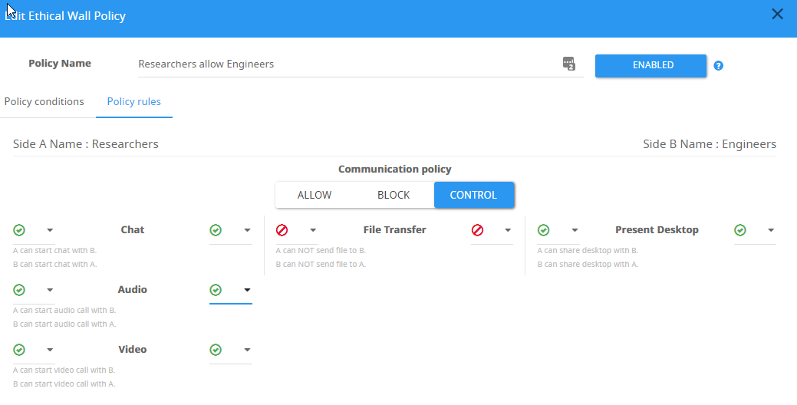
Ethical Wall Policy Rules
Control specific modalities
Audio
Video
Messages (IM)
File transfer
Share Desktop/Applications

Slide 16
Ethical Wall Scope
Covers all MS Teams scopes: Chat, Teams & Channels and meetings
Recursive validation of joined users into multiple participants communication

Slide 17
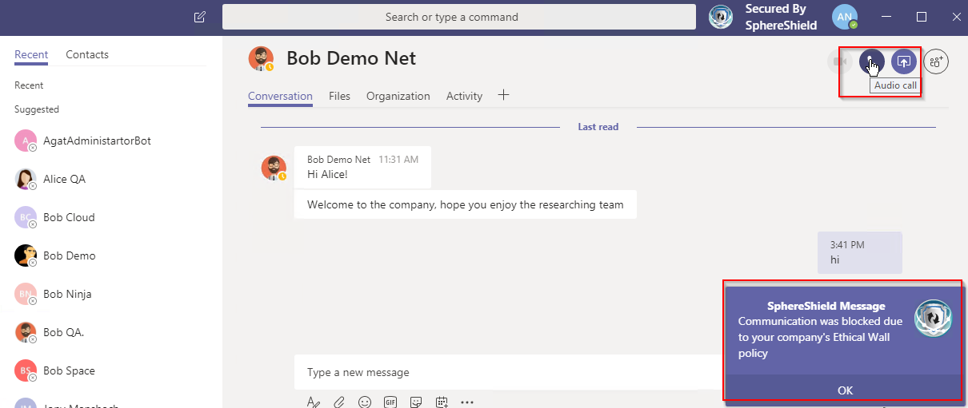
End User Notifications
In Context Message
Action Feedback Popup

Slide 18
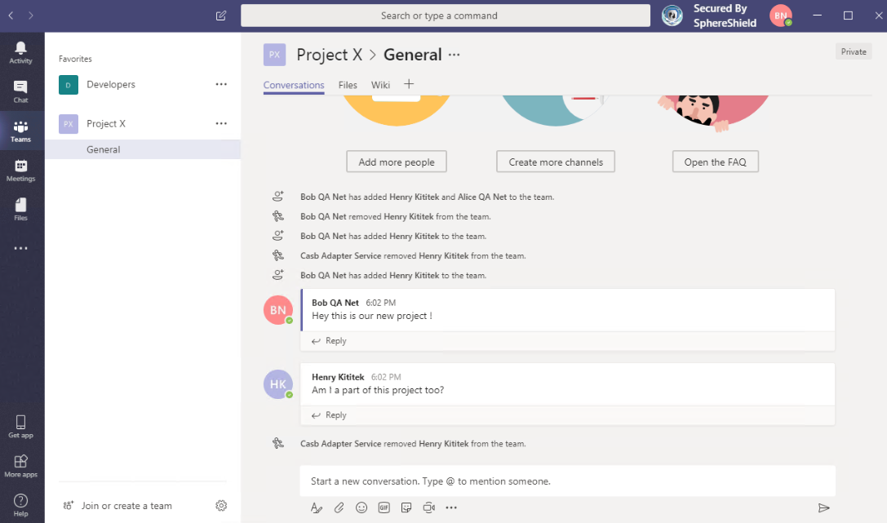
Removing Unauthorized Users From a Team

Slide 19
Pre validate Meeting
SphereShield validates all meetings as soon as they are scheduled before they start
The user violating the policy will be removed.
A message will be sent to organizer.

Slide 20
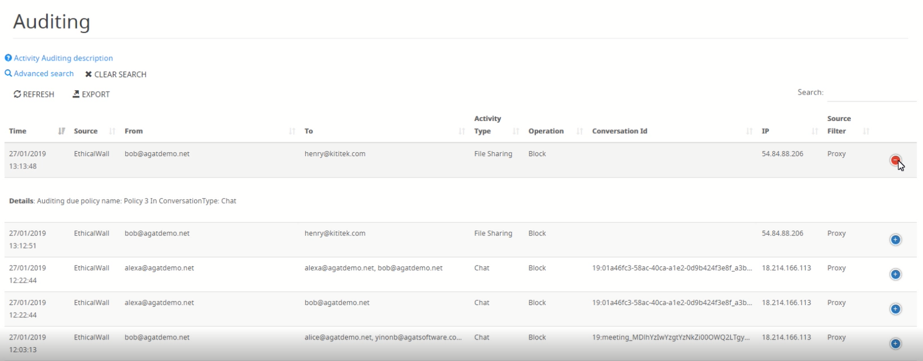
Auditing & Reports

Slide 21
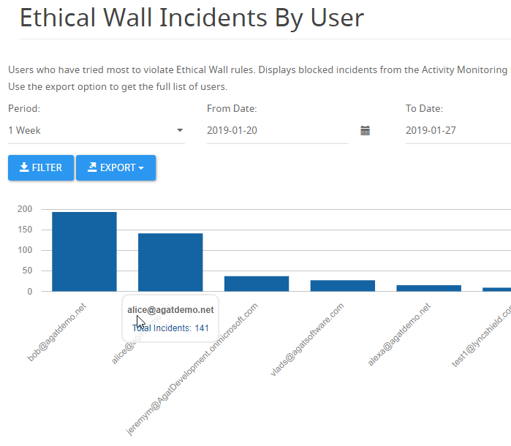
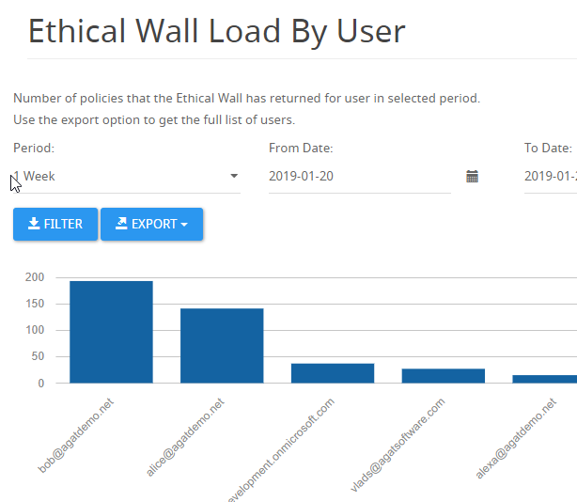
Reports

Slide 22
Ethical Wall
 | Office 365 |  | AGAT
License | Essential | E5 (Info Barriers) | SPT2
Internal control parameters | N/A | Groups/Users | Groups/Users/Domain
External Control Parameters | External- Domain Internal - Org. wide |  | External - User/Domain Internal - Groups/Users/domain
Control Modalities (IM’s/files/audio/video/ screensharing) | No | No | Yes
Management role accessibility | O365 admin |  | Compliance officer
User Experience for Internal control | N/A | PowerShell/CLI | GUI (User Friendly)
Notification | N/A | No | Yes (End user and officer)
Auditing & Reports | N/A | No | Yes
External system integration/SIEM | N/A | No | Yes (Windows event log)
Price/User/Month | $5.00 | $35.00 | $1.2
Notes:
For external control MS offers guests and federation. You can add guests and allow domains. So you can start with a blacklist and add based on domain/user. Guests are not domain wide they can see only the team they are apart of. (maybe even channel) we can allow whitelist and block based on user /domain . Also blacklist and allo domain for a specific group/user.

Slide 23
Ethical Wall
 | Microsoft | AGAT
License → | Information Barriers Available only with E3+E5 Compliance | Ethical Wall
Internal control by Groups/Users | ✓ | ✓
External Control By External User | ✗ | ✓
External Control by Internal group/users/domain | ✗ | ✓
Control Modalities (IM’s/files/audio/video/sharing) | ✗ | ✓
Can be fully controlled by compliance role only | ✗ | ✓
Web User Interface (GUI) – Easy to operate | ✗ | ✓
Notifications to end user/admin | ✗ | ✓
Incident auditing for compliance awareness and training | ✗ | ✓
Notes:
For external control MS offers guests and federation. You can add guests and allow domains. So you can start with a blacklist and add based on domain/user. Guests are not domain wide they can see only the team they are apart of. (maybe even channel) we can allow whitelist and block based on user /domain . Also blacklist and allo domain for a specific group/user.

Slide 24
Ethical Wall (continued)
 |  | AGAT
License → | Information Barriers Available only with E3+E5 Compliance | Ethical Wall
Reports by user/policy/domain | ✗ | ✓
External system integration/SIEM | ✗ | ✓
Restrict Guests communication only to Team members | ✗ | ✓
Restrict access for guest only to specific channels in a team | ✗ | Soon
Price/User/Month | $10 - $15 | $1.2

Slide 25
DLP Inspection
Prevent sensitive data loss

Slide 26
DLP Use Cases
Realtime DLP (Active) - Preventing sensitive data being sent to the cloud and reaching destination
Scan all content used in Teams (stored in Exchange, OneDrive, SharePoint)
Prevent sensitive data from being sent to external users
Scan data shared with external / guest users
Taking advantage of existing DLP infrastructures, experience and policies

Slide 27
DLP Integration
Sending messages and files to existing DLP vendors or SphereShield DLP engine to meet existing policies.
*
* Coming soon

Slide 28
Watch the Videos
McAfee DLP
Integration
Symantec DLP
Integration
General DLP
Demonstration

Slide 29
SphereShield DLP Engine
Content policy rules
Based on content
Such as Social Security
numbers, credit card
Numbers, ID numbers
And more
Actions
Block, Mask, Notify
Group membership
based rules

Slide 30
DLP Main Features
Inspect all traffic or only outbound traffic.
Inspects Files and messages

Slide 31
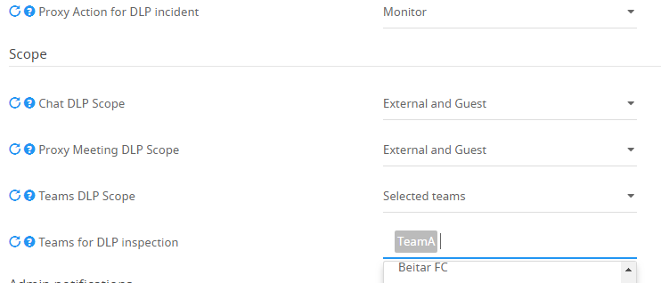
DLP Main Features
Apply DLP policies for MS Teams chat, meetings or selected teams and channels.

Slide 32
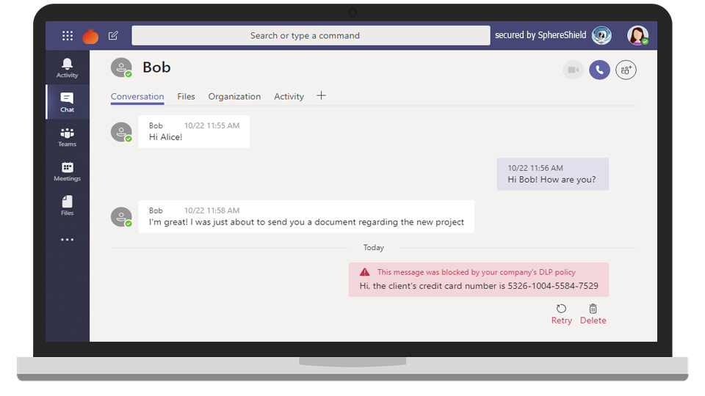
DLP Main Features
Optional in context IM notification messages.

Slide 33
DLP Main Features
Incidents are displayed in SphereShield Admin Portal along with content and AD users info.
(Product can be configured to disallow saving of message-data to fit regulation)
When deploying a DLP integration, incidents will be displayed at the vendor’s incident manager.

Slide 34
DLP
 | Office 365/E5 | AGAT
Sensitive data reaches destination user | Yes | No
Sensitive data reaches MS Cloud | Yes | No
Real Time Audio inspection | No | Yes
MS Stream recording inspection | No | Yes
Inspect traffic sent to external users | No | Yes
Integration with existing Vendors | No | Yes
Price/User/Month | $35.00 | $1.2

Slide 35
DLP
 | Office 365 (add on) | AGAT
Sensitive data blocked from reaching destination user | ✗ | ✓
Sensitive data blocked from MS Cloud | ✗ | ✓
Real Time Audio inspection | ✗ | ✓
MS Stream recording inspection | ✗ | ✓
Inspect traffic sent to external users | ✗ | ✓
Inspects files for custom rules | ✗ | ✓
Can be controlled by DLP Admin only | ✗ | ✓
Integration with existing Vendors | ✗ | ✓
Price/User/Month | $10-$15 | $1.2

Slide 36
Compliance Recording
Meet compliance requirements.

Slide 37
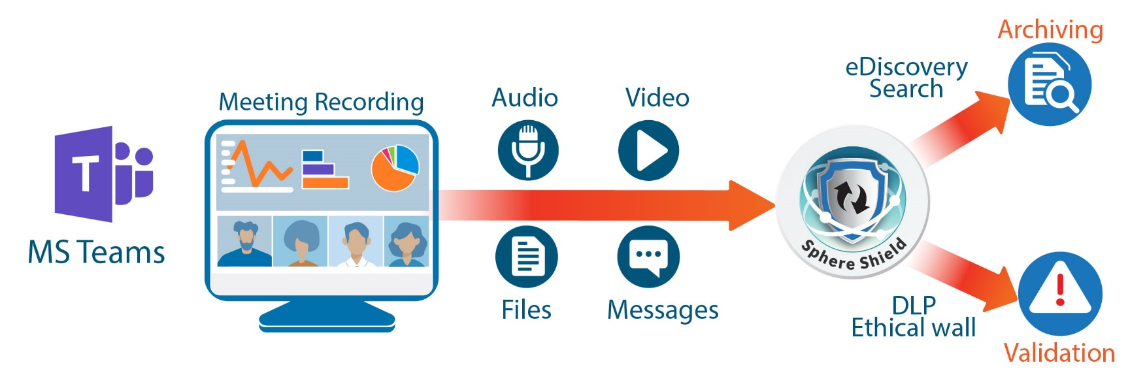
Recording and analysis
Manage and analyze recording done by users
Recording enforcement policy
Real-time audio analysis
Share video externally

Slide 38
Main capabilities
Transcript all users meeting audio
Converts speech to text in 12 languages with automatic language detection
Speaker enumeration: which speaker spoke which words and when.
Meeting eDiscovery - make meeting searchable by:
Dates
Attendees name and type - Internal / External
Text -Audio, Video, Keywords, Labels, Names, etc.
Inspect meeting content by DLP policies
Audio transcript
On screen OCR from video and screen/document sharing

Slide 39
Main capabilities (continue)
Smart DLP incidents with link to video and transcript time
Inspect all meetings or only meetings with external users
Ethical wall – Detect meeting Users/Groups attendee compliance conflicts based on regulation policies
Option to store video archiving on prem
Hosted SaaS or on-prem
Use SphereShield build in DLP engine or integrate with leading vendors
Symantec
McAfee
Google
GTB
Forcepoint

Slide 40
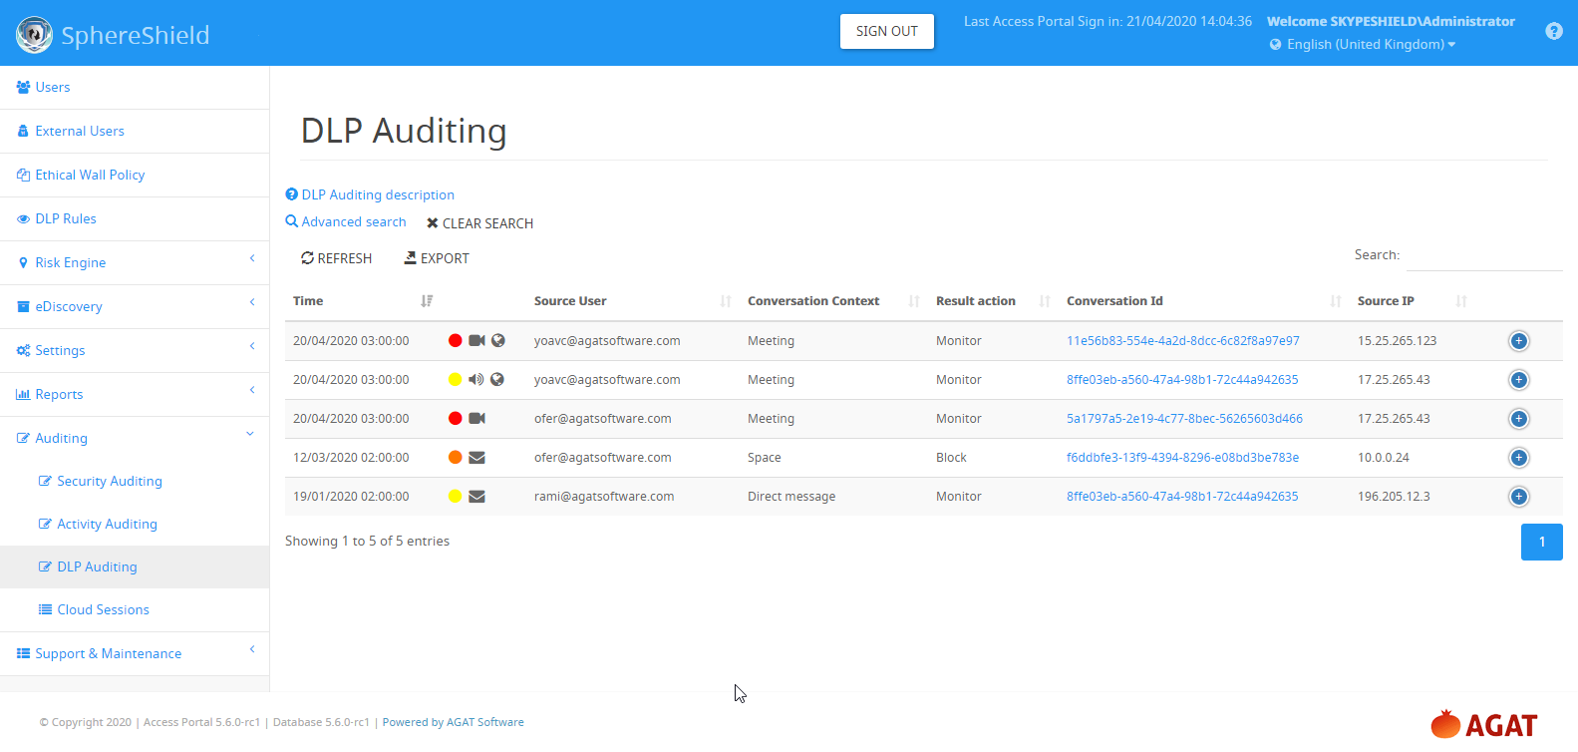
DLP Auditing info
Content Type
Message
File
Audio / Video
Action
Block
Monitor
Additional data
Policy
Meeting info
Message
Context
Meeting
Space/channel
Direct message
Scope
Internal / External
Compliance risk
High
Medium Low
eDiscovery
Link to record

Slide 41
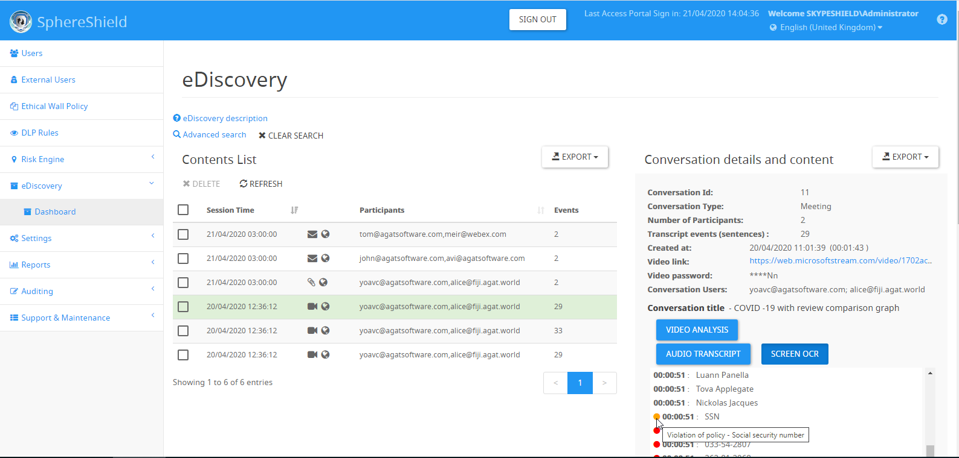
Recording eDiscovery dashboard
Meeting details
Meeting scope internal/ external
Open advanced search
Video OCR
Advanced insights
Audio Transcript
Content type
DLP policy violation
Color risk level

Slide 42
Recording enforcement policy
Force recording
Allow / Block ability to record
Parameters:
Meeting with external
Per groups
Per user
Per domain
User can get public link to Video in order to share with any user outside or inside the company
Share Video Externally

Slide 43
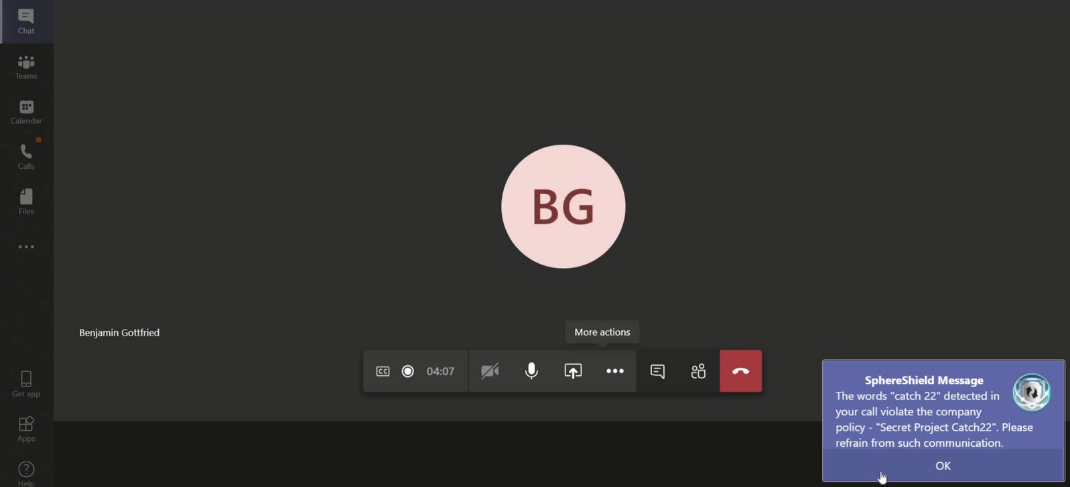
Real-time audio DLP
Send in real-time audio text for DLP inspection
Display popups when violation occurs

Slide 44
Compliance Recording
 | 0365 | SphereShield
Video/Audio eDiscovery | ✗ | ✓
Create transcript of meeting Audio 70 languages | ✗ | ✓
AI Linguistic Analysis | ✗ | ✓
DLP analysis of Audio transcript | ✗ | ✓
DLP analysis of Video OCR | ✗ | ✓
User Identity detection | ✗ | Soon
Recording enforcement policy | ✗ | ✓
Share Video Externally | ✗ | ✓

Slide 45
eDiscovery
Meet GDPR and compliance requirements
Full data dashboard independent of O365

Slide 46
eDiscovery
Advanced search by text, user, dates and more
Archive data on cloud or on site
Integrate with existing
eDiscovery systems
Search for personal information and export user data
See message context
in incidents
Support files and
messages

Slide 47
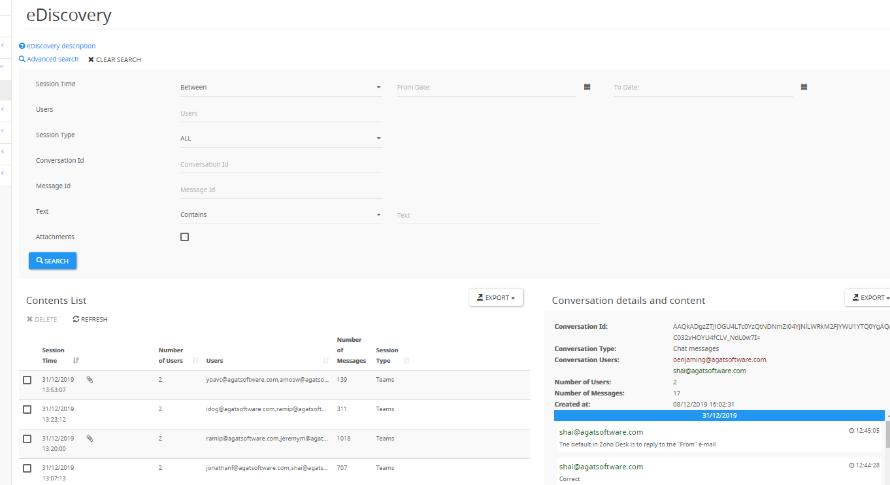
eDiscovery

Slide 48
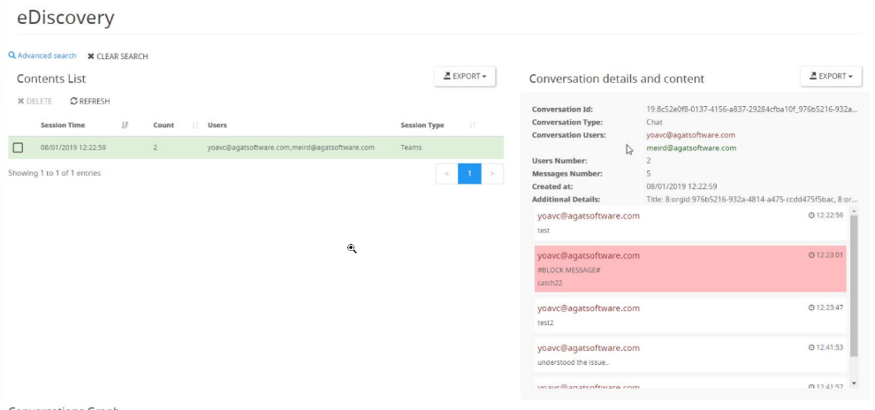
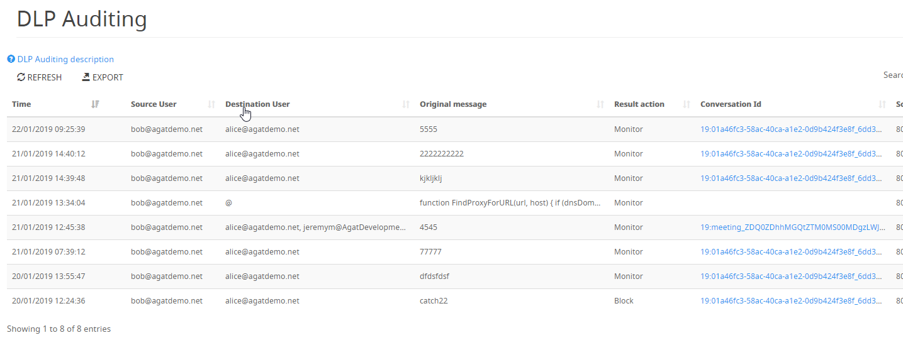
DLP Integration with eDiscovery
Ability to view conversation context from DLP incident.

Slide 49
eDiscovery
 | Office 365 | AGAT
User Friendly | No | Yes
Role for operating | O365 admin | HR/Compliance
Audio transcript search | No | Yes
On Prem Archive option | No | Yes
Integrated with DLP (to show context of incident) | No | Yes
Notes:
Data put on Hold
Yes
No

Slide 50
Archive & eDiscovery
 | MS Advanced eDiscovery (Add on) | AGAT
User Friendly | ✗ | ✓
Operated even by non O365 Admin (HR/Compliance) | ✗ | ✓
Audio transcript search | ✗ | ✓
On Prem Archive option | ✗ | ✓
Integrated with existing archiving/database systems | ✗ | ✓
Integrated with DLP (to show context of incident) | ✗ | ✓
Search meeting audio and video | ✗ | ✓
On-prem archive of all data (messages/ files/ recordings) | ✗ | ✓
Notes:
Data put on Hold
Yes
No

Slide 51
Channel Management
Boost productivity
Address compliance

Slide 52
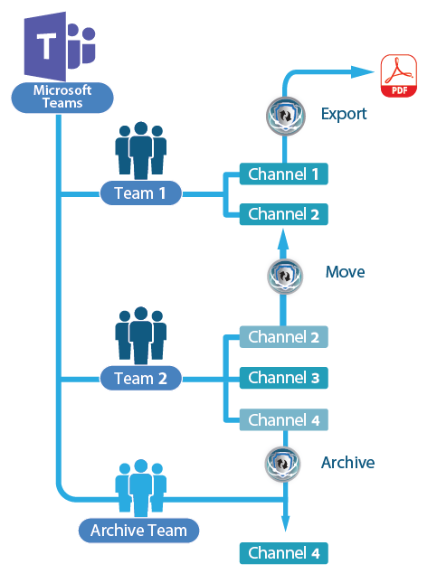
Channel management
One of the top requested feature in MS Teams user voice
Archive and restore a channel
Move channel from one team to another
Export channel into PDF
Activity auditing
https://www.youtube.com/watch?v=E2RLEjzW3Nc

Slide 53
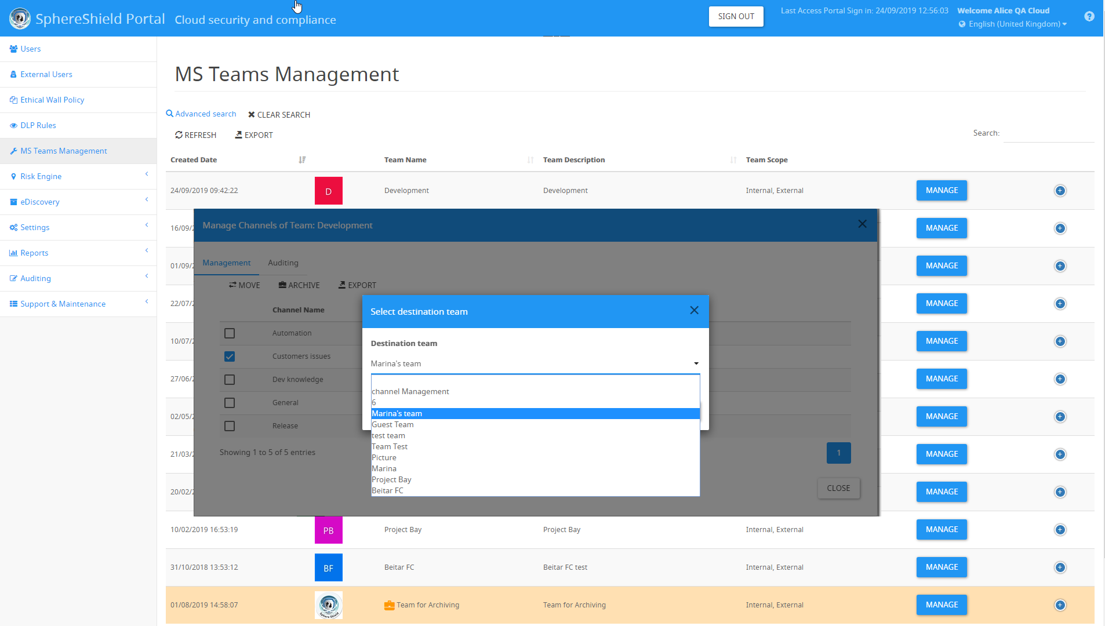
Channel management portal

Slide 54
Channel Management
 | Office 365 | AGAT
Move/Copy/Merge | ✗ | ✓
Archive | ✗ | ✓
Export | ✗ | ✓
Messages/posts/images | ✗ | ✓
Files | ✗ | ✓

Slide 55
Channel Management (continued)
 | Office 365 | AGAT
Special Wiki / OneNote | ✗ | ✓
All other Tabs | ✗ | ✓
Convert public to Private (soon) | ✗ | ✓
Notes:
Data put on Hold
Yes
No

Slide 56
Conditional Access
Restrict access only to managed device

Slide 57
MDM Conditional Access
Restrict access to Teams only to managed device
Verify device compliance level
Certificate based authentication
Server side API integration with MDM vendor
Available for:

Slide 58
Risk Engine
Meet security requirements

Slide 59
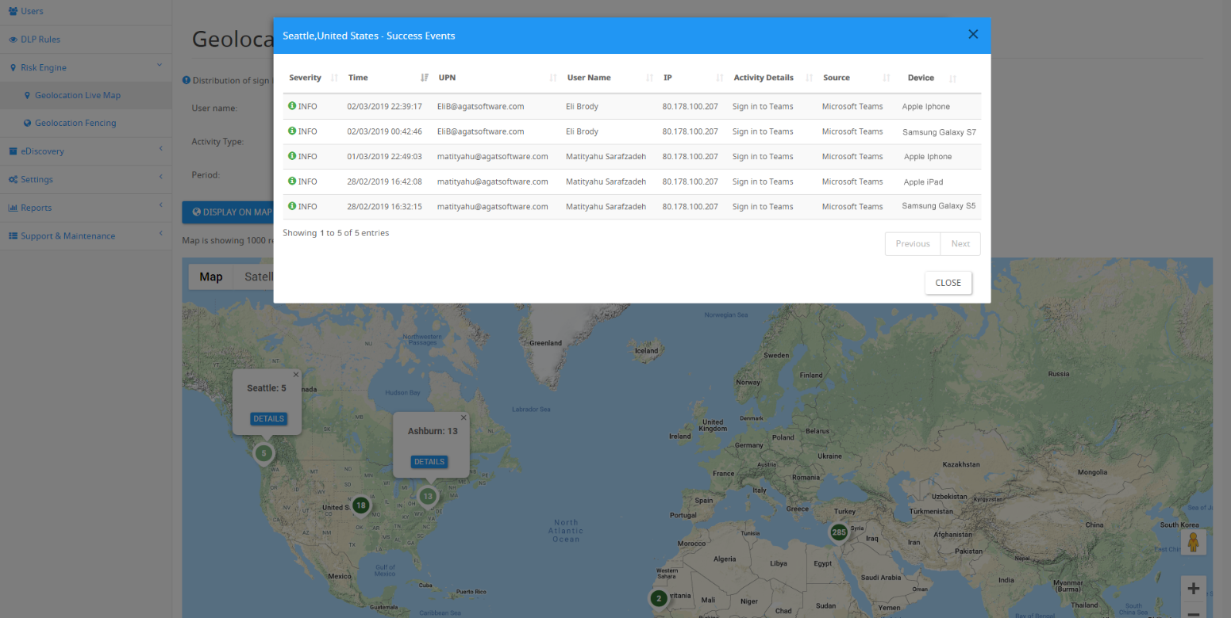
Geo Location Live Map

Slide 60
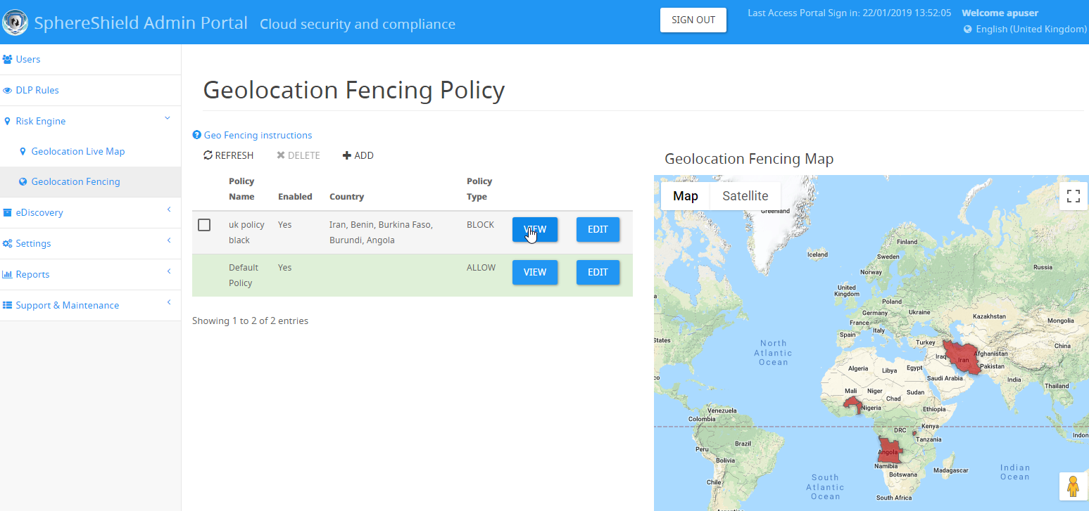
Geo Fencing

Slide 61
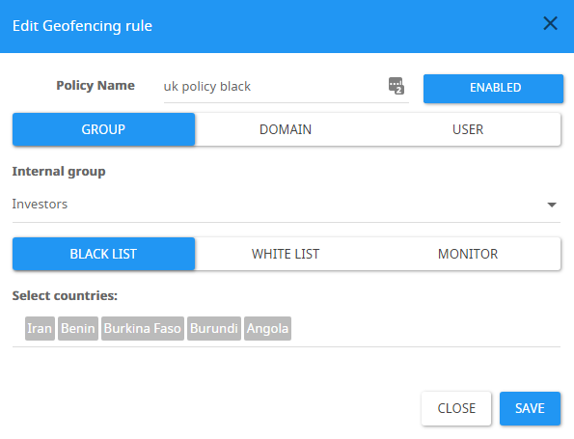
Geo Fencing Settings
Set Geo Fencing rules based on groups, domains or users.
Allow, block or monitor access from specific countries.

Slide 62
User Entity Behavior Analytics- UEBA
Profile Teams usage (messages, files, hours, devices, IP etc)
Detect anomaly
Create and handle security events
Examples:
Location change / Impossible traveler
Large data consumptions

Slide 63
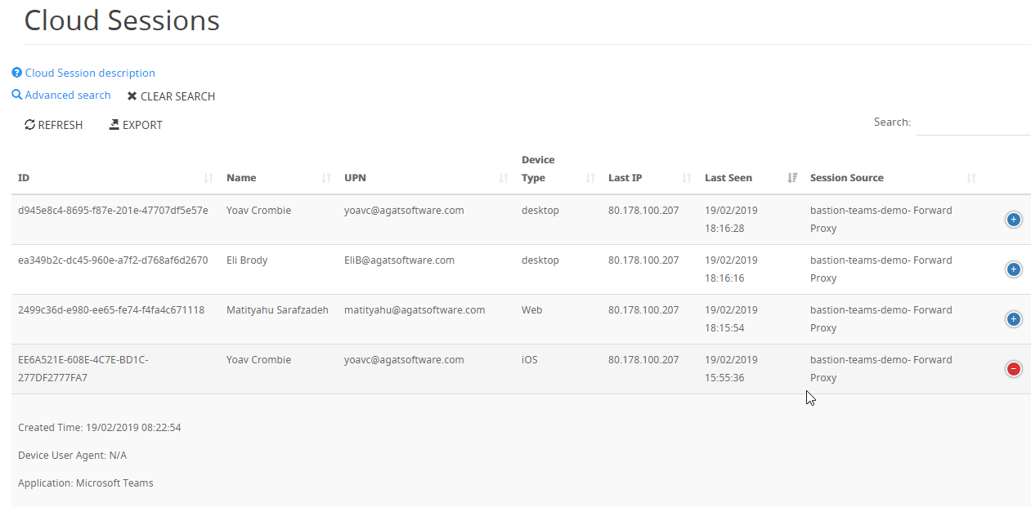
Cloud Sessions Report

Slide 64
Threat Protection
Anti Malware
Anti Phishing

Slide 65
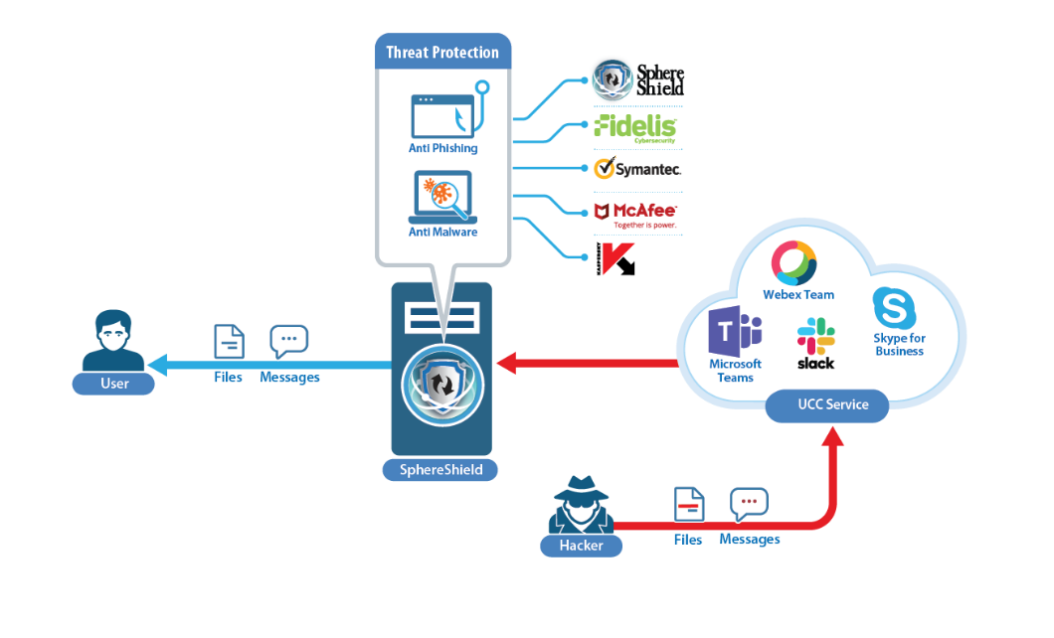
Threat protection
Scan files and messages
Identify and handle malwares/ Viruses
Scan before use can download file
Build in engine and integrate with leading vendors:
McAfee
Symantec
Kaspersky
Fidelis

Slide 66
Features Comparison
 | SphereShield | Microsoft Teams
DLP integration with leading vendors
Realtime Data in motion DLP inspection
Global messaging policies per user
Global external domain control
Ethical wall context-based policies
Geofencing*
Antivirus with leading vendors
Offsite eDiscovery and data governance
On site archiving
Channel archiving / move
Teams Heuristic and AI risk engine UEBA*
*Partially covered with advanced Azure licenses

Slide 67
Operation modes & Topology

Slide 68
DLP modes
Real-time inspection
Scan data in motion
Content will not reach destination
Near Real-time inspection
Scan data at rest
Content will be sent
Incident and deleting content just after reaching cloud
Covers existing and new content
Inspect all Exchange / One drive and SharePoint

Slide 69
Ethical wall modes
Real time control
Block communication before established
Near real time control
Communication will be allowed. Incident handling and notification sent shortly after

Slide 70
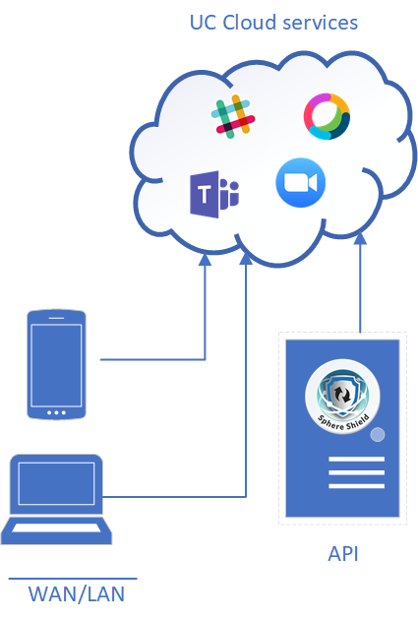
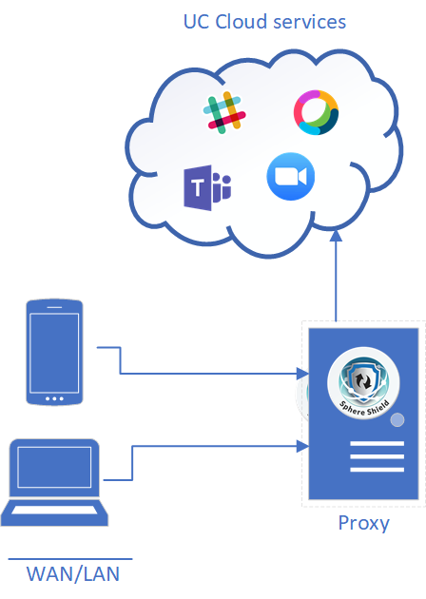
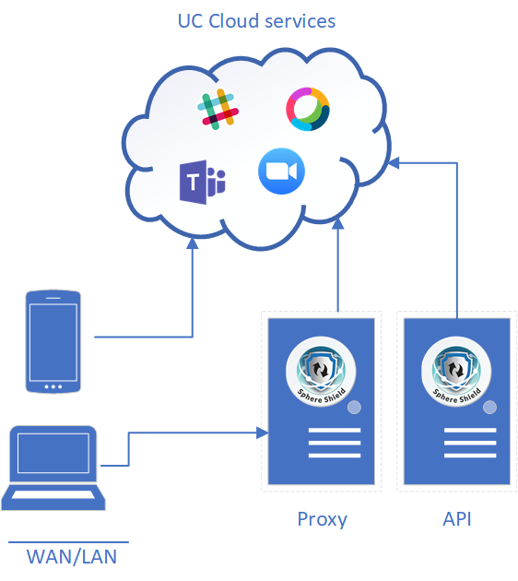
Cloud Topology
API
Proxy
Hybrid- Proxy & API

Slide 71
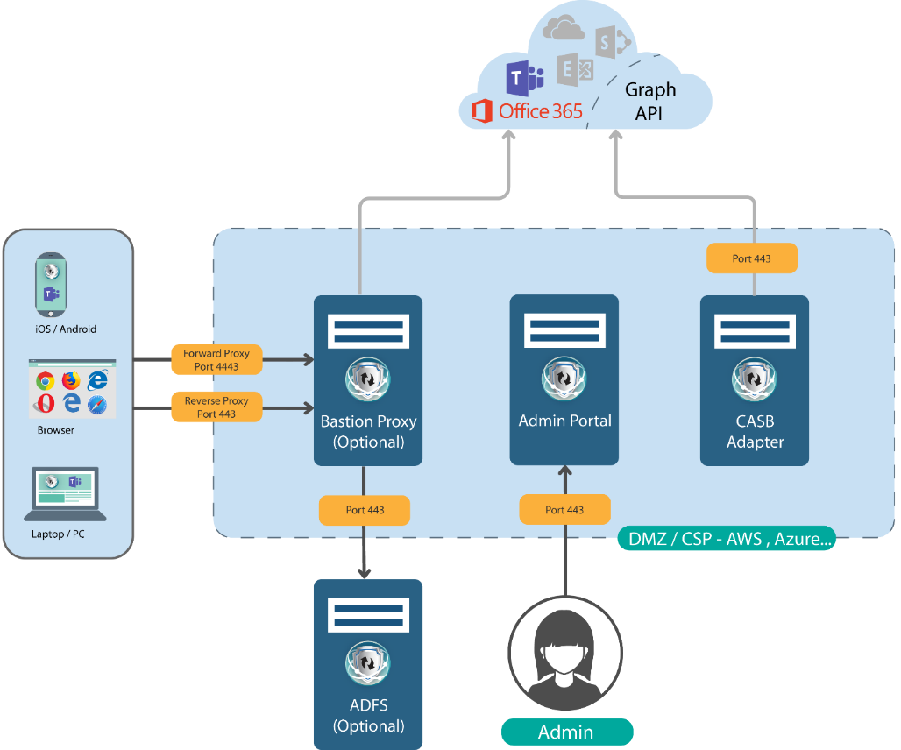
Topology details

Slide 72
Component needed for each feature
CASB Adaptor Only
Bastion Proxy
Required when deploying
Near Real Time DLP / Antivirus
Near Real Time Ethical wall
Risk Engine
eDiscovery
Required when deploying
Real Time DLP / Antivirus
Real Time Ethical Wall
MDM
Easy deployment
Complex deployment

Slide 73
Deployment modes comparison
 |  | Real time using Proxy |  | Near Real time using Adaptor
Policy type |  | Prevent |  | Pro active
 |  | Client configuration | Requirements | Client configuration | Requirements
Mobile |  |  | Agent Certificate
PC | with ADFS |  | Publish ADFS by Bastion
 | without ADFS |  | PAC Certificate
Yes
No
No
Yes

Slide 74
Service offering
SphereShield is available as two options.
SaaS - online service
Customers don’t need to install anything.
Each customer will have dedicated servers
A customer installation solution
Customers install SphereShield in their DMZ or Cloud (e.g. Azure, AWS)

Slide 75
POC - AGAT dedicated SaaS Cloud machines
POC – Install on customer machines (cloud / DMZ)
Trial Options

Slide 76
Link the Demo
We offer a demonstration environment to demonstrate the abilities of SphereShield for Teams.
The trial can be done using AGAT demo users or using your own account.
Try It

Slide 77
Try it yourself with demo users
AGAT provides you with the following:
Credentials to access 3 demo machines using RDP
Machines are pre configured with 3 users, (Bob, Alice, Jim)@agatdemo.net
Credentials for external demo user domain -henry@kititek.com. Can be used from any browser/PC
Access to admin portal - https://admin.agatdemo.com
Detailed step by step scenarios to test and demo the solution

Slide 78
Experience the Demo with Your Own Users
Configure PAC file
Install certificate
Your activity will be monitored here: https://admin.agatdemo.com

Slide 79
POC - AGAT dedicated Cloud machines
Contact support@agatsoftware.com to get access to dedicated servers for your POC
No server installation required by customer
POC is free of charge
Hosted in Amazon AWS

Slide 80
POC - Install on customer machines
Contact support@agatsoftware.com to get latest software and system requirements
Once ready schedule install session with our support
POC is free of charge

Slide 81
Road Map

Slide 82
SphereShield for Teams road map
Message broadcasting -sending messages to groups
Disclaimers

Slide 83
Q&A

Slide 84
More Info
Visit our website
https://AGATSoftware.com
Contact us
info@agatsoftware.com
+972-525209860

Slide 85
Thank you

